Slide 1

A.C.M.E.: Automated Collection and Manipulation of Email
Ryan Peters

Slide 2
Project Outline
Objective: what are we doing here?
Identify existing competitor technologies
Tools and technologies used in this project
Terse program flow diagram
How to make program do objective
Task automation
Discretize stages of program flow – give a name to the program’s unique stages of execution
Parallelable execution – identify which stages may execute concurrently
Sequential dependencies – identify stages that depend upon the output of another
Data preprocessing
Data collection from imap server – initially collect header data only
Parsing and message id generation from imap header information – ensures no duplication of data
Caching and rudimentary security measures – download, encrypt, and save new messages; to keep an honest person honest.
Message body isolation and parsing. – content type identification, encoding corrections, attempt to identify signatures (messy)
Apply NLTK tools – strip “stop-words”, lemmatize, “wordbag”/”tf-idf”, cache
Visualize, analyze, and sensualize… yeah baby
Full link addresses – All embedded links found throughout this presentation will also appear in this final slide in it’s fully expanded form.

Slide 3
Project Objectives
An often-overlooked key to effective collaboration and successful industry networking is to maintain focus on the human element of an interaction.
Help people break away from having to invest hours of their day trying to leverage past accomplishments, freeing them to put their time and energy into new ideas, stronger connections, or simply that all too neglected “me” time.
The need for this project arose from the realization that there is an absence of open-source tools for automated classification, storage, and response to communications that need to promote healthy human interaction.
Initially based on email messaging, this project aims to maintain strong modularity that promotes ongoing development into additional communication mediums, new application domains, and to permit future scalability.
This project provides:
Tools to automate away the tasks that distract from the human elements of a conversation.
Classifying incoming emails into actionable and informational.
Identify message patterns that result in unpersonal specifications gathering
Possible plans for automated response generation in the future.
Automated pipeline for adding objectives extracted from emails to appropriate categories in task/Kanban boards.
Notes:
In any line of work, it is generally obvious that one must organize available resources, keep track of various communications, and assign priority levels to their objectives; as doing these things effectively will often bring direct, measurably improved, results. It can even become a point of obsession for some, but at what cost?
When we become overly focused on tasks we can easily measure, we do so at the expense of those elements which serve as force multipliers for those tasks.

Slide 4
Tools and technologies used in this project
Development tools:
Python 3.8 and libraries:
NLTK -- Natural Language Processing tools.
SQLite 3 -- SQL bindings wrapper for database implementation in Python.
Doit -- Multi-stage task automation package that orchestrates the automated execution of the project’s sub-modules.
Pandas -- Data exploration package used in diagnostic evaluation of word counts and NLP tools as project is developed.
Numpy -- Efficient data containers and optimized data manipulation algorithms.
Numba -- JIT compilation of arbitrary python code to significantly faster c++ representations.

Slide 5
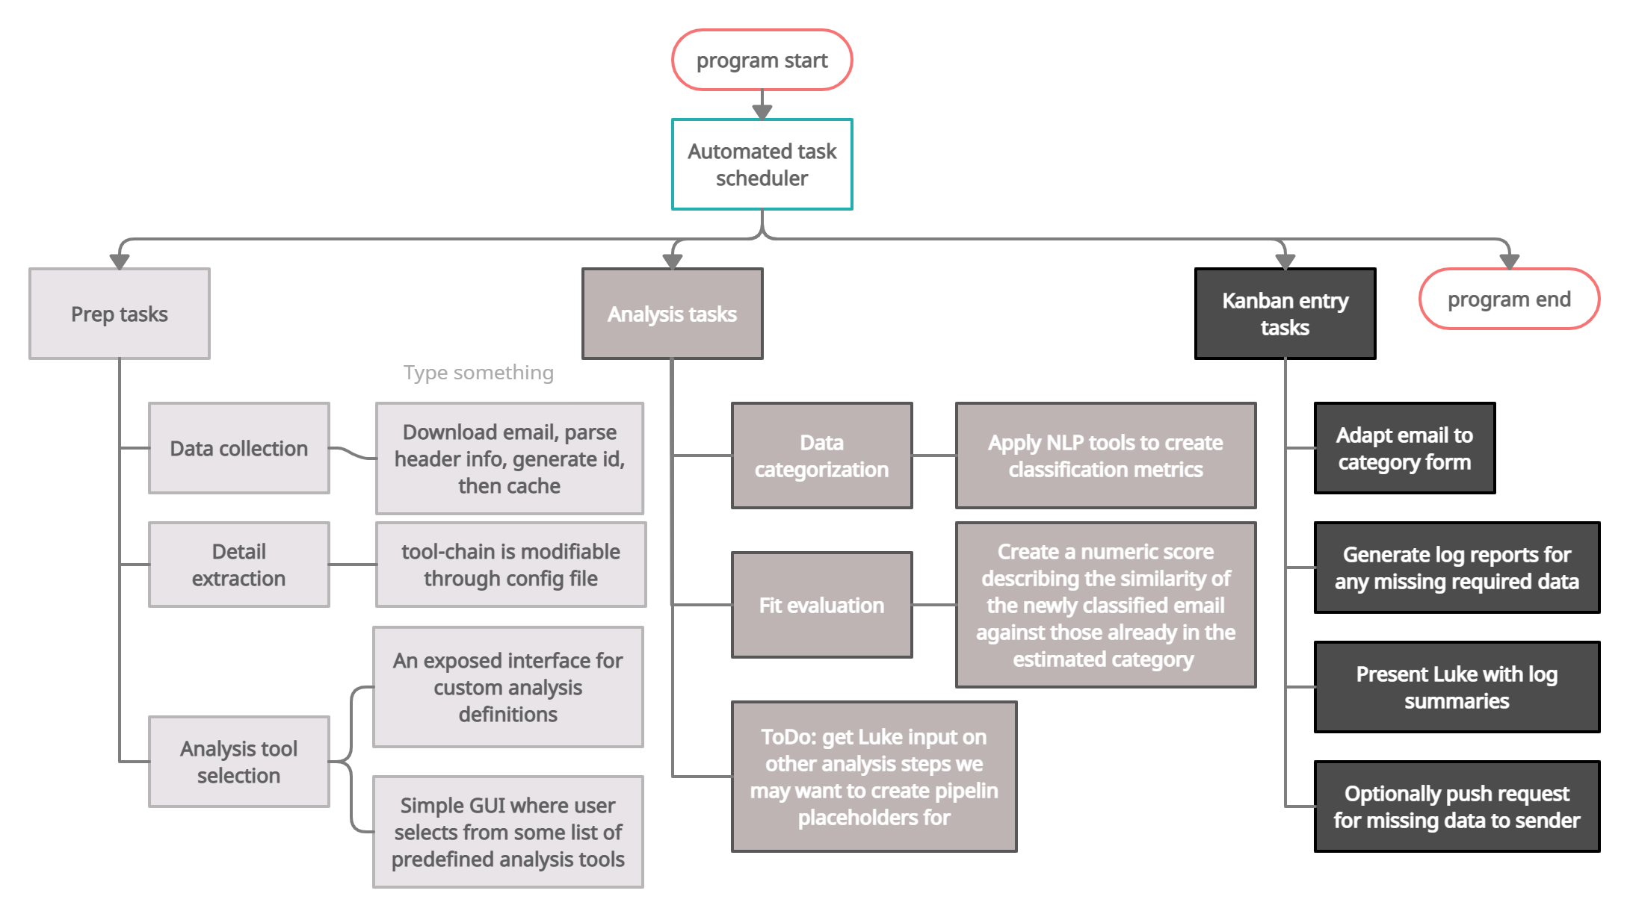
Project Breakdown
Notes:
Get rid of program start and program end
Get better term for “task decomposition”
maybe” Project breakdown”

Slide 6
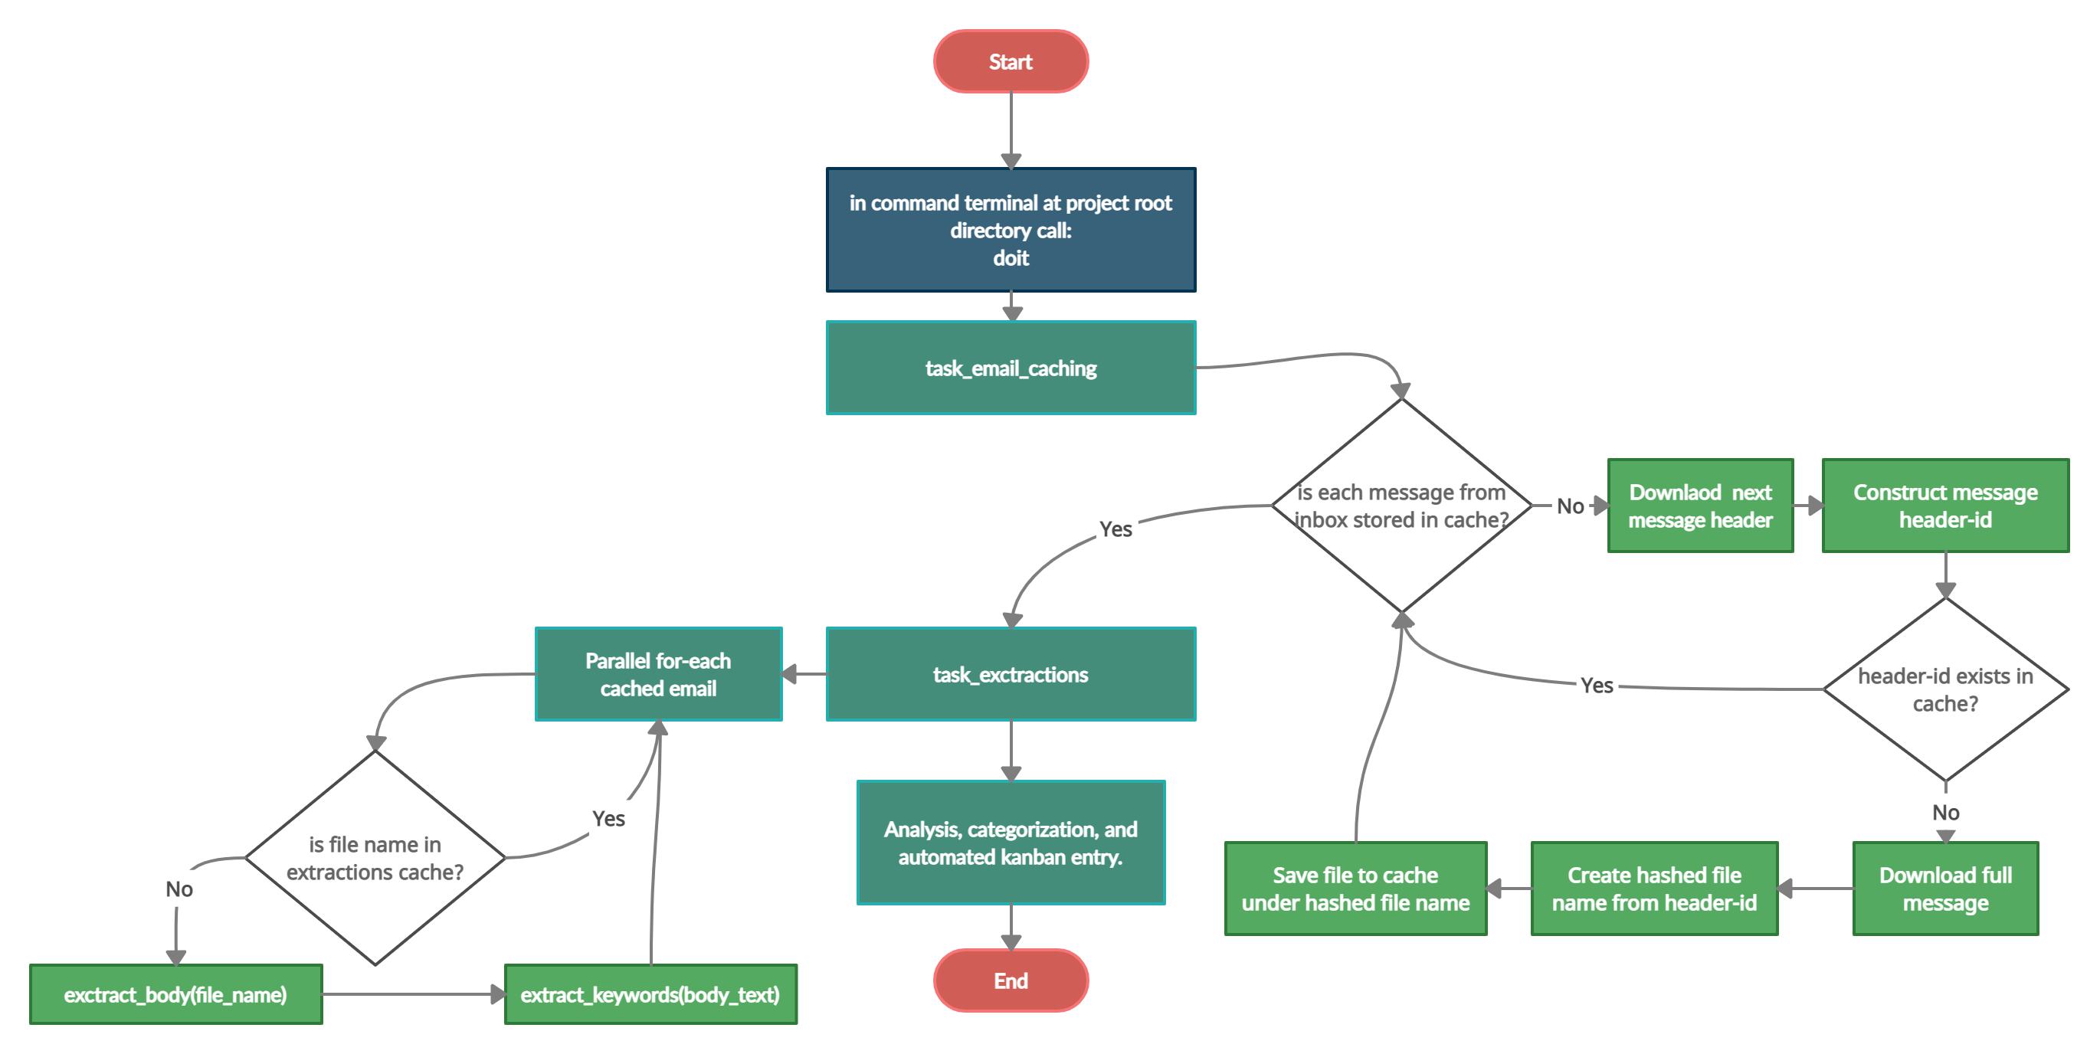
Program Flow

Slide 7
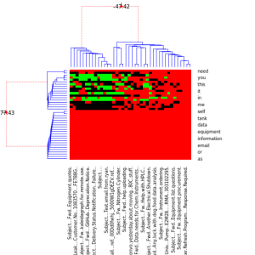
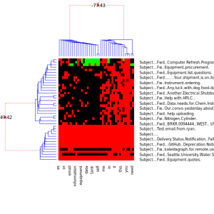
Email Classification
Bayesian Hierarchical clustering (BHC)
Notes:
Things to add to slide:
Say that it’s in R
We can now say we classified emails as well.

Slide 8
Conclusion
This should be a bulleted list of what was done, what the next steps look like,
(maybe interesting points along the way)
and finally, a thank you!
Thank Prof. Erdly, Dr. Marney, the UWB CSS dept, Kiera, and anyone else
that conceivably contributed.

Slide 9
Full link addresses
NLTK: Natural Language Toolkit for Python
https://www.nltk.org/

Slide 10
Existing Competitors
Notes:
We are working towards building a tool that lets a user get into the nuts and bolts of the automation, not an end product that just does it all for them.

